Slide 1


Letter Recognition
Hands on Machine Learning Project - 2024
07.07.2024

Slide 2

The Dataset
The dataset is from UC Irvine Machine Learning Repository. It was donated on the 31st of December, 1990. As such it is a quite old dataset.
It has 20, 000 instances- which were formed by writing the 26 English alphabets in 20 different fonts and randomly distorting them- and 17 attributes- which describe a feature of a black-and-white rectangular pixel display.
The 17 attributes are: letter, x-box, y-box, width, height, onpix, x-on-bar, y-on-bar, xvar-bar, yvar-bar, xy-corr-bar, x²ybar, xy²bar, xeg-bar, xegy-corr, yeg-bar, yegx-corr
Each sample represents a handwritten black-and-white image of a letter of the English alphabet.

Slide 3

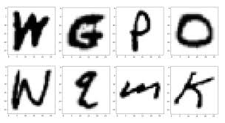
The Attributes
Attribute | Meaning
x-box | Horizontal position of letter
y-box | Vertical position of letter
width | Width of letter
height | Height of letter
x-on-bar | Mean position of on pixels horizontally
y-on-bar | Mean position of on pixels vertically
xvar-bar | Horizontal spread of on pixels from the mean
yvar-bar | Vertical spread of on pixels from the mean
xeg-bar | Mean edge count of on-pixel boxes from left to right
yeg-bar | Mean edge count of on-pixel boxes from top to bottom
xegy-corr | Correlation of x edge count with y-on-bar
yegx-corr | Correlation of y edge count with x-on-bar
xy-corr-bar | Mean of x-y correlation of on-pixels
onpix | Total number of on pixels in a box
letter | The letter of the alphabet corresponding to the sample

Slide 4
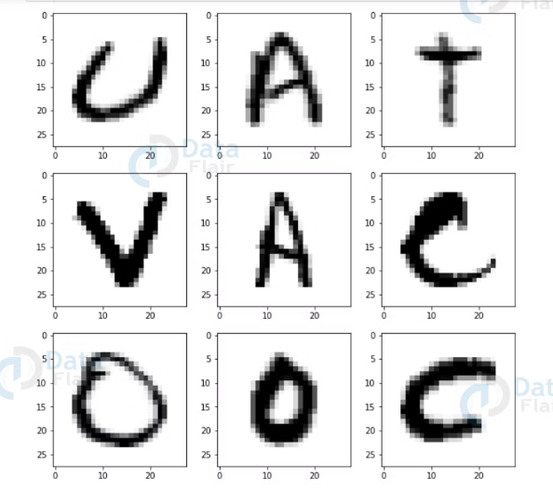
The Goal
-The goal is to recognize 26 capital letters from numerical descriptions of black-and-white pixel images.
-As such this is a supervised machine learning-task, and since the target variable is categorical, this is a multiclass classification problem.
-Since this is a balanced dataset, I'll be using accuracy as the metric for scoring.
-In the end, I use a confusion matrix and a classification report to evaluate my model.

Slide 5

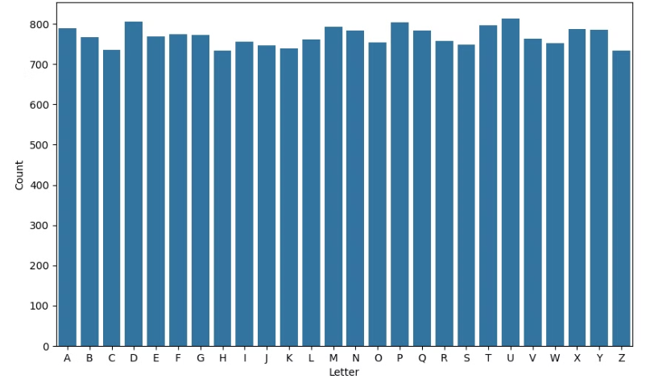
Distribution of target class
The proportion of each class seems to be fairly equal.
The classes are relatively balanced, with each letter class having around 3.67% to 4.06% of the total samples. This balance helps ensure that the model doesn't become biased toward any particular class.

Slide 6
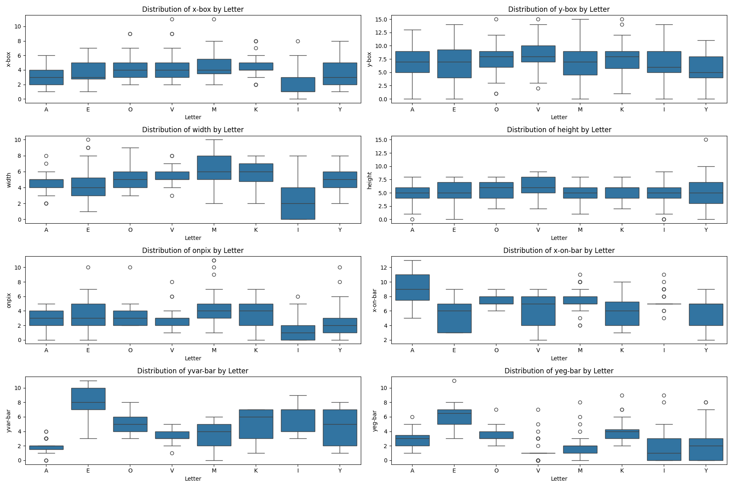
Feature Analysis I
The dataset comes with its values already scaled to fit integer values from 0 to 15.
The mean of the features range from 3.0 to 8.3, with most features having a moderate spread around the mean, 'y-box' however has the biggest spread which is 3.3.
Here, we can also see that letters like ‘V’ tend to have a lower edge count than letters like ‘E’ counting from top to bottom .
Letters like ‘I’ seem to be centered around the middle of the box, in the horizontal axis, with very little spread.

Slide 7
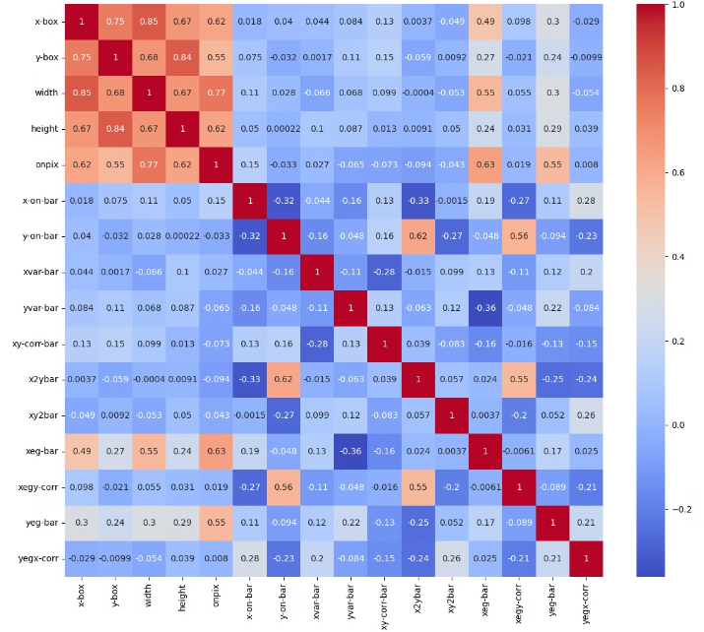
Feature Analysis II
The correlation matrix reveals some moderate linear relationships among certain features.
The noticeably moderate correlations suggest that the choice of letter class is likely influenced by a combination of features rather than a single dominant predictor.

Slide 8
Feature Analysis II contd.
x-box and width, y-box and height: The strong correlation of 0.85 suggests that the horizontal box position is strongly related to the letter width and vertical box position is closely related to the letter height.
onpix and width: a correlation of 0.77 shows that more on-pixels are associated with wider letters.
x2ybar and y-on-bar: correlation of 0.62 indicates that the interaction between x and y is significant for vertical "on" pixels.
xeg-bar and onpix: The moderate correlation of 0.63 suggests that edge detection in the x direction is related to the number of "on" pixels.
yeg-bar and onpix: Moderate correlation of 0.55 indicates that edge detection in the y direction is also related to the number of "on" pixels.

Slide 9
Machine Learning Approaches
In this part of the project, I trained the dataset on:
K Nearest Neighbours (KNN) model
SGD One vs. Rest model
Logistic Regression model
Decision Tree
I initially trained the models without any preprocessing since there was no need for feature scaling, or imputing and there were no categorical features.
However after the first try with the initial features, I used Polynomial Features of degree 2 with reduced dimension by passing the features through PCA and achieving an explained variance ratio of 0.98 at 40 principal components.

Slide 10



K Nearest Neighbours Model
Standard Model
Standard Model and Polynomial Features
Tuned Model
Train Score: 0.971
Train Score: 0.963
Train Score: 1.0
Validation Score:0.944
Validation Score: 0.929
Validation Score: 0.952
Hyperparameters Tuned: Number of neighbors (n) Relevant Features: Features related to the position and dimensions of the box

Slide 11
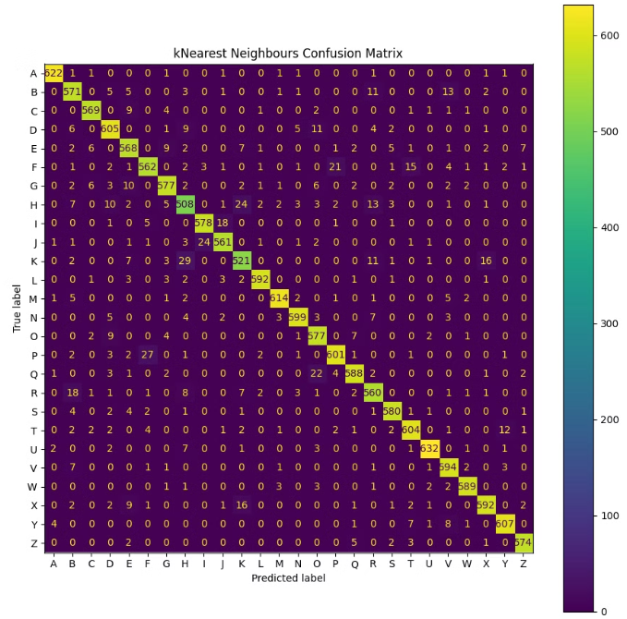
KNN Performance
Letters like 'A', 'C', 'L', 'M', and 'W' are classified well by the model.
There are several pairs where the model tends to confuse one letter for another. For example:
'K' is often predicted as 'X', 'I' is frequently predicted as 'J', 'F' is predicted as 'P' and vice versa, 'R' is predicted as 'B'.
These show that the model struggles to distinguish certain letters that share similar features or shapes. This could be due to the similarities in the visual representation of these letters.

Slide 12




Logistic Regression
Standard Model
Standard Model and Polynomial Features
Tuned Model with Polynomial Features
Train Score: 0.78
Train Score: 0.875
Train Score: 0.871
Validation Score: 0.772
Validation Score: 0.846
Validation Score:0.85
Hyperparameters Tuned: 'l2' Regularization parameter C= 0.0119
Performance Analysis: The best performance occurred with polynomial features, but even with that the model was only classifying 'A' well.

Slide 13
Decision Trees
Standard Model
Standard Model and Polynomial Features
Tuned Model
Train Score: 0.997
Train Score: 0.989
Train Score: 0.999
Validation Score:0.864
Validation Score:0.747
Validation Score: 0.869
Hyperparameters Tuned: Criterion, max depth
Relevant Features: x-box, y-box, width, height
Here we can also see that the model heavily overfits

Slide 14
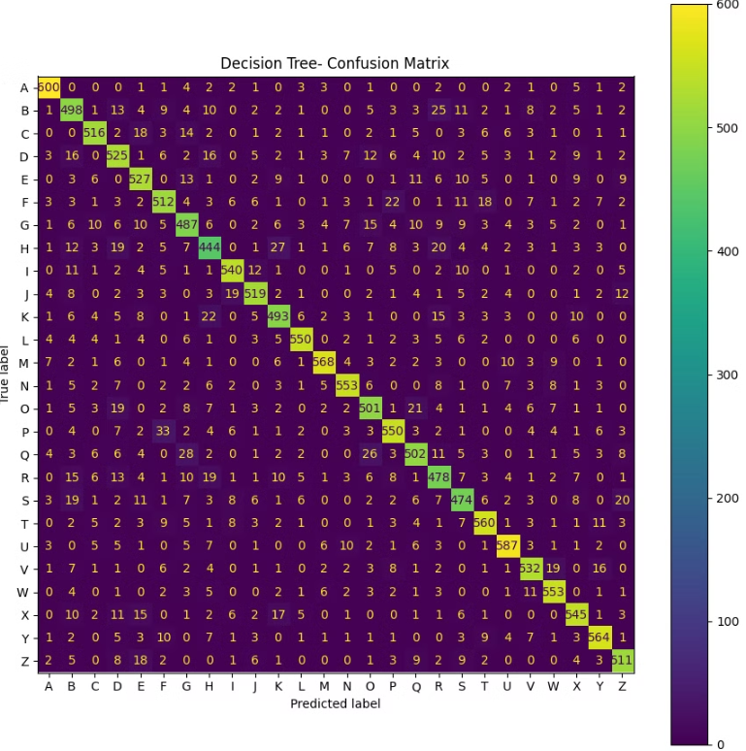
Decision Tree Performance
The Decision Tree model performs slightly better than the logistic regression but worse than the K Nearest Neighbours. The model performs worse than kNN with regards to 'B', 'C', 'D', 'O', 'S', 'V' and 'Z'. But on a more positive note, the model seems to classify 'A', 'L' and 'N' well.

Slide 15

Putting It All Together
We've explored a range of machine learning models and techniques for the letter recognition task. Now let's consider how to build an effective system that leverages the strengths of these approaches.
In the following, I used several ensemble methods to enhance predictive performance. This included: - bagging with the knn model, and utilising random forest and decision tree models - boosting with Histogram Gradient boost and Adaboost
- putting the models together with a voting classifier.

Slide 16

Bagging Methods
Random Forest
Extra Trees
KNN Bagger
Hyperparameters: n_estimators, max_features, max_depth
Hyperparameters: n_estimators, max_features, max_depth
Hyperparameters: max_samples, max_features
Train Score: 1.0
Train Score: 1.0
Train Score: 0.994
Validation Score:0.954
Validation Score: 0.953
Validation Score: 0.951

Slide 17



Boosting Methods
Histogram Gradient Boost
AdaBoost
Hyperparameters: 'min_samples_leaf', 'max_leaf_nodes', 'max_depth', 'learning_rate'
Hyperparameters: 'n_estimators', 'learning_rate', 'estimator'
Train Score: 0.994
Train Score: 0.992
Validation Score: 0.949
Validation Score: 0.935

Slide 18




Voting Classifiers
Bagging Classifier
Boosting Classifier
Classifier for All
Hard Voting
Train Score: 1.0
Train Score: 0.991
Train Score: 0.9999
Validation Score: 0.914
Validation Score: 0.939
Validation Score: 0.950
Soft Voting
Train Score: 1.0
Train Score: 0.998
Train Score: 0.999
Validation Score:0.951
Validation Score:0.953
Validation Score:0.955

Slide 19

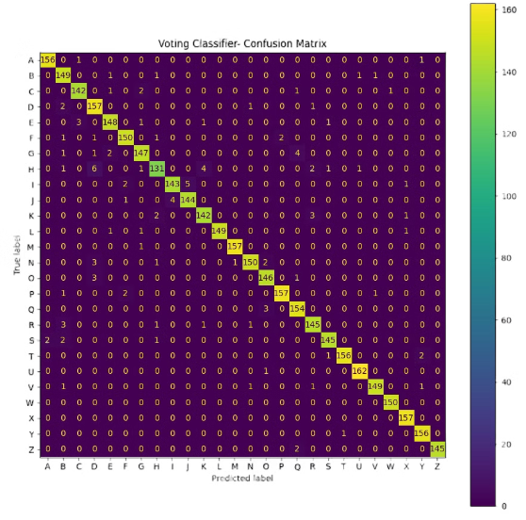
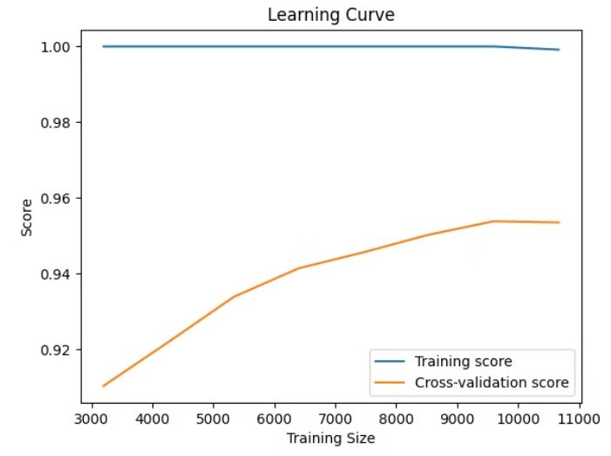
Voting Classifier Performance Analysis
The model is not underfitting the training data.
Classes like 'M', 'U‘, 'W' and ‘Z’ have very high precision and recall scores. Classes like 'B', 'C', 'H', 'I', and 'R' have slightly lower precision and recall compared to the top-performing classes, but still within a very good range .
As the training size increases, the validation score appears to converge just around 0.96.
The high training score coupled with a lower cross-validation score suggests potential overfitting.

Slide 20

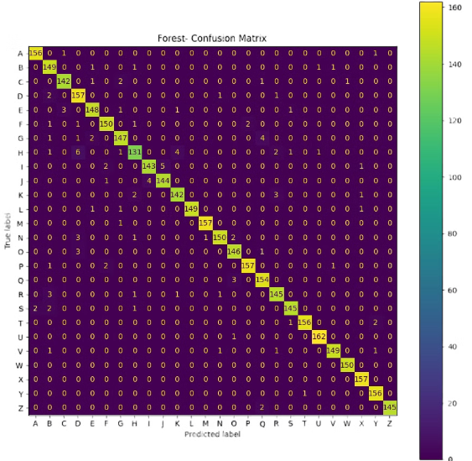
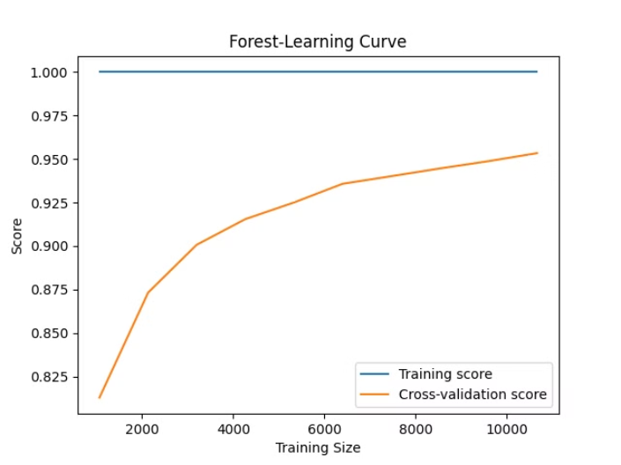
Random Forest Performance Analysis
The model is not underfitting the training data.
Classes ‘M’, ‘W’, ‘X’, ‘Y’ and ‘Z’ have near-perfect scores across precision, recall, and F1-score. The lowest scores (92%) are for precision, recall, and F1-score for class D, indicating it had relatively more false positives and false negatives compared to other classes.
The model's generalization performance improves with more training data.
The learning curve suggests potential overfitting.

Slide 21
Suggestions for future exploration on the dataset
Data Augmentation
Feature Selection and Engineering
The random forest model could be revisited with more training data, using data augmentation and more extensive hyperparameter tuning. They could also be used to investigate the more misclassified letters
The feature importance could be used as a guide for alternative feature selection or engineering techniques, to capture more relevant patterns.
Logistic Regression
Other Models
One could revisit the logistic regression model with polynomial features of higher degrees.
One could use XGBoost or delve into deep learning models using neural networks on the dataset.

Slide 22

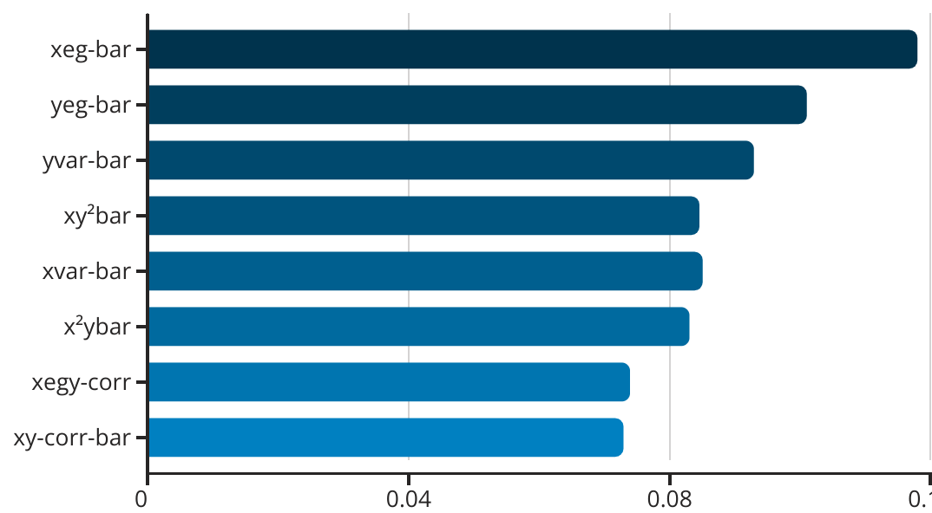
Feature Importance for Random Forest Model
The bar chart shows the feature importance scores for the key attributes used in the Random Forest model. The most important features are xeg-bar and yeg-bar, followed by yvar-bar and xvar-bar. The least important features were the height, x-box and width, which could be because a lot of letters have similar heights and widths, except the very obvious cases like 'I'.

Slide 23

Machine Learning Models Overview
Model | Final Test Score
Logistic Regression with Polynomial Features | 0.855
Decision Tree | 0.884
AdaBoost Classifier | 0.946
KNN Classifier | 0.96
KNN-Bagging Classifier | 0.96
Histogram Gradient Boost Classifier | 0.965
Voting Classifier | 0.097
Extra Trees Clasifier | 0.097
Random Forest Classifier | 0.972

Slide 24

CONCLUSION
After comparing performance, the results indicate that the Random Forest classifier outperforms the Voting Classifier in terms of overall performance.
Analysis of the learning curves further reinforced our findings since the validation score for the Voting Classifier plateaued at a training size of approximately 10,000 samples, suggesting that it reached its maximum learning capacity early and could not significantly improve with additional data. In contrast, the Random Forest classifier's validation score continued to rise with increasing training size, indicating that it can benefit from more data and has not yet converged.
Given these observations, I would recommend the Random Forest classifier for this dataset. This model's capacity to improve with more data also suggests its potential for further enhancement as additional training samples become available.

Slide 25

Thank you for listening
By : Beatrice Nhyira Nyarko

